Slide 1
AOOP Lab8: Jupylet
TA: 陳子祈
Notes:
1

Slide 2
Outline
Jupylet
Introduction
Installation
Demo 1
Demo 2
Notes:
卡內基美隆大學視覺語言自主挑戰賽在導航自主中利用電腦視覺和自然語言理解。
這項挑戰賽旨在突破真實環境和真實機器人中嵌入式人工智慧的極限——提供機器人平台和工作自主系統，使每個人的工作更接近現實世界的部署。
該挑戰賽提供了一個配備 3D 雷射雷達和 360 度攝影機的真實機器人系統。
該系統具有機載基礎自主能力，可估計感測器姿態、分析地形、避免碰撞並導航至航路點。
團隊將在機器人的機載電腦上設定軟體，以與系統互動並導航機器人。
2024 年，挑戰將在自訂模擬環境中完成，並於隔年轉移到真實機器人系統。

Slide 3
Jupylet - Introduction
Jupylet is a Python library for creating 2D and 3D games, graphics, music, and sound synthesizers interactively in Jupyter notebooks.
It is designed for various users, including deep reinforcement learning researchers, musicians interested in sound synthesis, and children who are learning to code.
This lab will introduce you to the installation of Jupylet and provide an overview of its features.

Slide 4
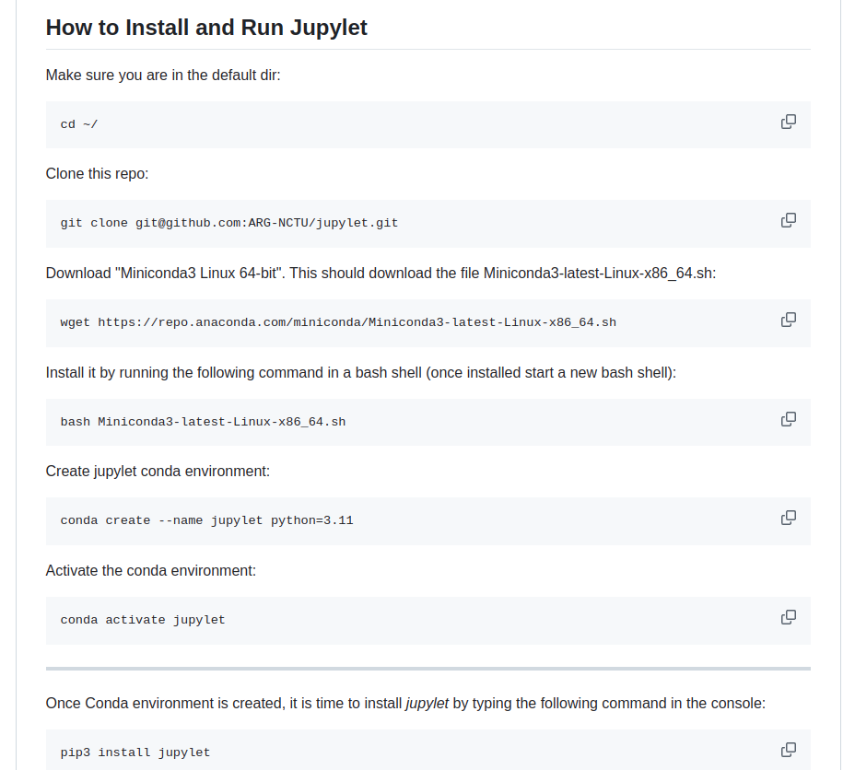
Jupylet - Installation
Please refer the github: https://github.com/ARG-NCTU/jupylet
Run all installation command in your terminal:

Slide 5

Demo 1 – examples/11-spaceship.ipynb
No need for modify code. Just run the code. Read the code and show me how to play it:

Slide 6
Demo 2 – examples/12-spaceship-3d.ipynb
No need for modify code. Just run the code. Read the code and show me how to play it:

